Slide 1
1. Introduction
Practical Data Science (PDS)

Slide 2


Your teachers
Lecture: Prof. Dr. Gunther Gust
Exercise: Viet Nguyen
Inhaber des Lehrstuhls für Wirtschaftsinformatik und Künstliche Intelligenz im Unternehmen (seit 2022)
Forschung und Lehre über die Anwendung von KI in Unternehmen und Gesellschaft
Smart Grids
Smart Mobility
Smart Cities & Urban Analytics
Ausbildung: KIT, ITESM Monterrey, Uni Freiburg, Lawrence Berkeley National Laboratory
Stipendiat Stusti & Heinrich Böll Stiftung
Computer Science and Engineering (Bachelor) at the Frankfurt University of Applied Sciences and the Vietnamese-German University
Data Engineering and Analytics (Master) at the Technical University of Munich (graduated with distinction)
Data Science Intern: Knorex, Ho Chi Minh, Vietnam
Software Engineer: mesoneer, Ho Chi Minh, Vietnam

Slide 3
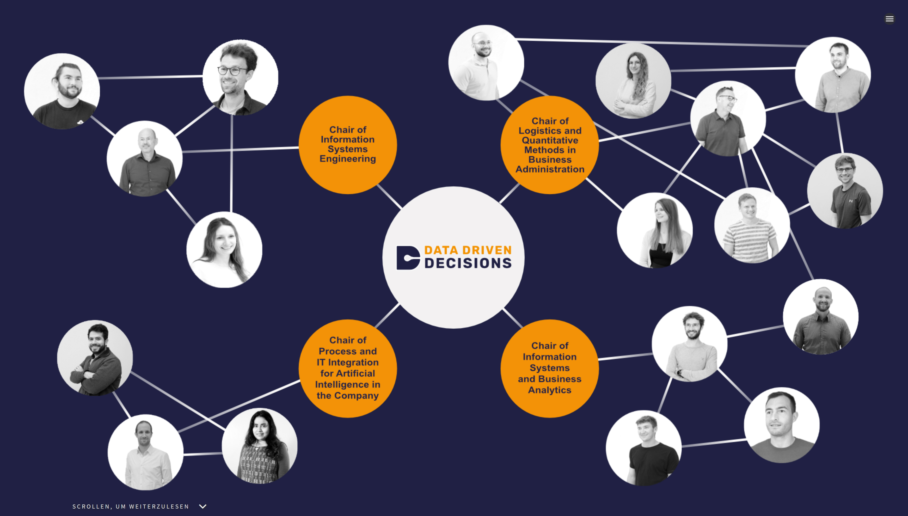
D3 Group

Slide 4
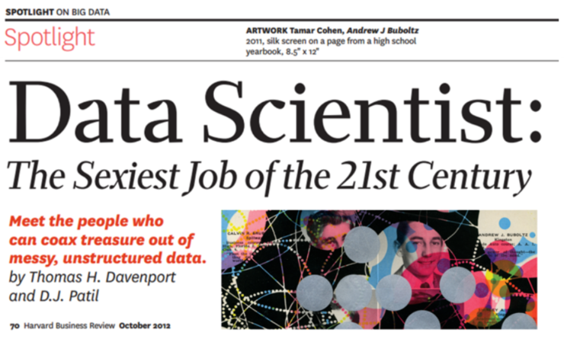
This course introduces data science tools, as well as advanced methodologies in an applied manner

Slide 5
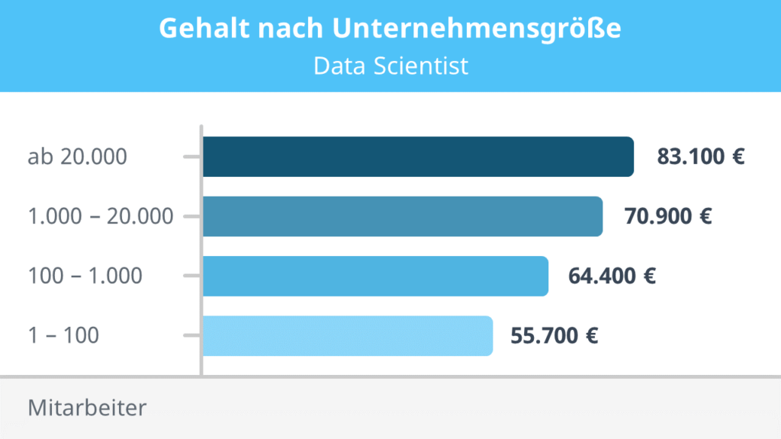
It prepares you for promising positions in practice
https://studyflix.de/jobs/berufe/data-scientist-gehalt-6028

Slide 6
Learning objectives for this course
The foundations, frameworks and applications of the emerging field of data science
Design, implement, and evaluate the core algorithms underlying an end-to-end data science workflow, including data import, analysis, and presentation of information
Leverage the Python application programming interface (API) ecosystem and data infrastructure that supports data acquisition, storage, retrieval and analysis
The application of a data-based analytical approach to identify and solve problems
Implementation and execution skills for data-driven business analytics

Slide 7
Course Schedule
Introduction, Jupyter Notebooks, Version Control (today)
Descriptive Analytics
Machine Learning Introduction
Feature Engineering
Deep Learning on Tabular Data
Deep Learning for Computer Vision
Deep Learning for Image Segmentation, Geocoding & Capstone Project
Data to Production
Deep Learning for Natural Language Processing
NLP with Huggingface
Guest lecture
Group Work on Capstone Project
Final presentations (End of semester)
Oct – Dec
Jan & Feb

Slide 8
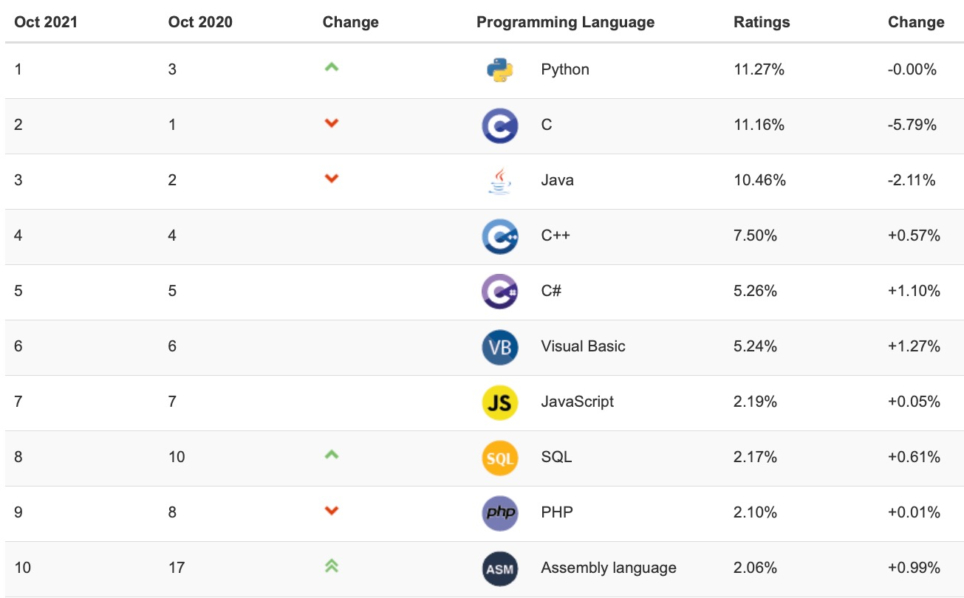
Why Python?

Slide 9
The course relates to several other courses of the D3 teaching program
Spreadsheet Modelling
Managerial Problem Solving
Business Intelligence
Enterprise AI
Practical Data Science
Tools
Programming & System Design
Programmieren für WiWis
Advanced Web Engineering
Mobile & Ubiquitous Business
E-Business Strategies
Digital Business
E-Business
IT-Management
Enterprise Information System
Data Driven Decisions in Practice
Applications
Vorstände berich-ten aus der Praxis
Smart Cities&Geo- spatial Analytics
Strategic Mgmt of Glob Supply Chains
Adv. Operations & Logistics Mgmt
Global Logistics & Supply Chain Mgmt
Logistics
Planen und Entscheiden
Simulation
for Decision Making
Managerial Analytics & Decision Making
Decision Support Systems
Theory & methods
Optimization
Datenmanagement und -analyse
Introduction to Data Science
Analytical Information Systems
Data Science in Economics and Business
Data Analytics
Bachelor
Master

Slide 10




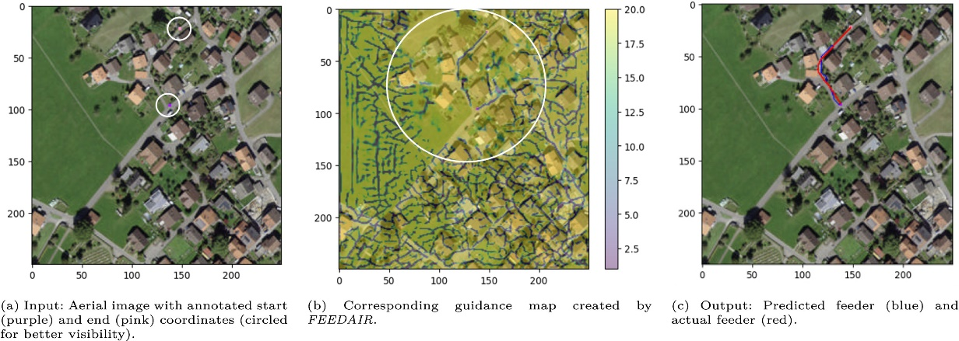


Die Forschung des Lehrstuhls für WI und KI im Unternehmen
Aktuelle Projekte und Themen (Auswahl)
Computer vision-based planning of electricity networks
Dynamic electricity pricing & load flexibility
Earthquake monitoring based on spatial sensor data and graph-convolutional neural networks
Mixed autonomous urban mobility systems
Multi-modal urban analytics
3. Domänen
1. Theoretische Einbettung
Digitale Transformation
Wirtschafts-informatik
Design of IS
Smart Cities and Industries
Data Analytics
Optimierung
Machine Learning
Energie
Industrie 4.0
Mobilität
Internet of Things
Infrastrukturplanung & betrieb
2. Forschungs-methoden

Slide 11

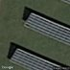
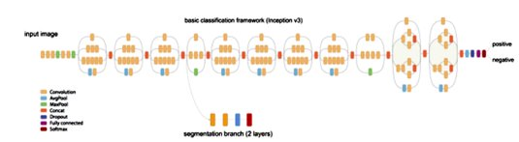

Our research: Deep Learning to Segment Photovoltaic Arrays
Deep Solar
Objectives
Detect solar PV systems based on areal images
Geocode the PV systems and estimate their size​
Results
First exhaustive data set containing the geolocation of PV systems for large regions of Germany
The data set serves as the basis for further analyses about the adoption of PV systems
In a follow-up project we plan to combine the PV data set with 3D city models​

Slide 12
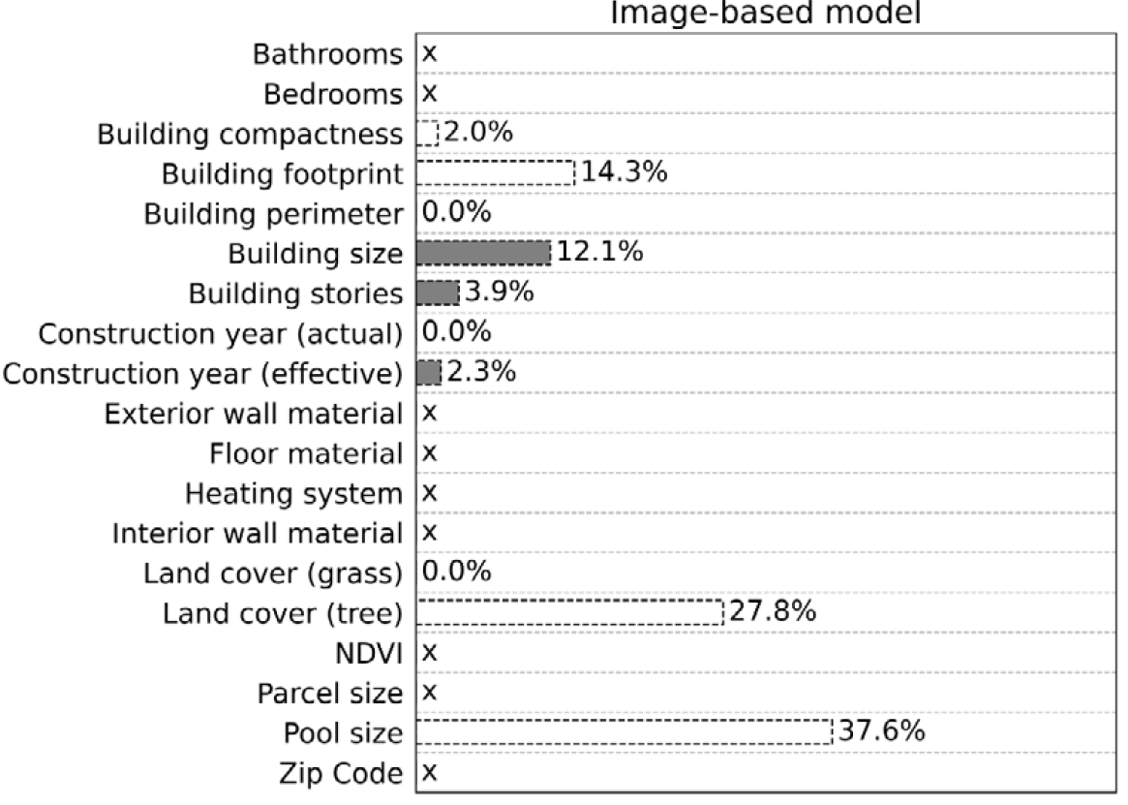
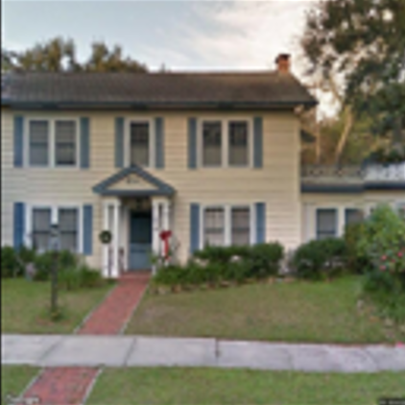
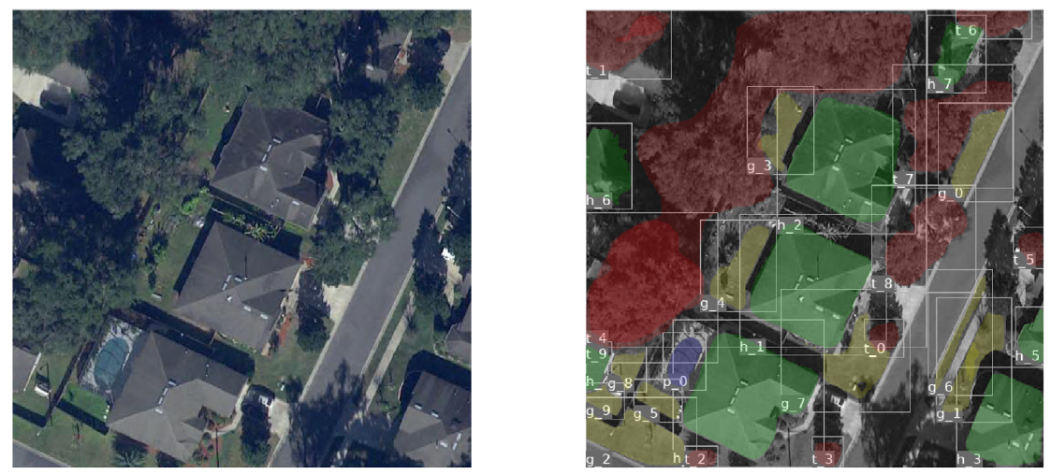

What can we learn from aerial images about residential electricity consumtion?
ROSENFELDER M, WUSSOW M, GUST G, CREMADES R, NEUMANN D (2021): Predicting Residential Electricity Consumption Using Aerial and Street View Images. Applied Energy.

Slide 13
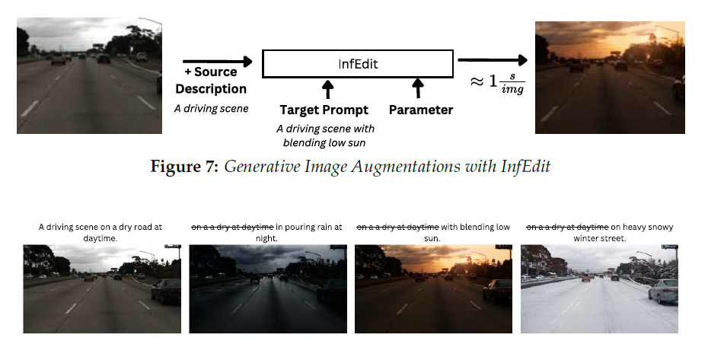
Using generative AI to create artificial training images for autonomous driving

Slide 14
Ways to work with us
Hiwi jobs (Bachelor‘s and Master‘s level)
Women are particularly encouraged to apply (see also Women@WIWI program)
Seminar thesis
Bachelor seminar
Master seminar
Project seminar
Bachelor‘s thesis
Master‘s thesis
Scholarships available
Doctorate
Applications are accepted on an on-going basis

Slide 15
Course Organization
Lecture
Mondays 14:15 – 15:45 (approx.)
Theoretical foundations
Implementation examples using Python
Exercise
Directly after lecture
Weekly assignments to be solved on your own
Published after lecture
Due 1.5 weeks later
Complete 4 out of 5 assignments to be eligible for final project
Meaningful participation in the WueCampus forum (or Discord Server) before Nov 30 counts as 1 assignment
Bonus (0,3 bonus for the exam)
Complete 5 out of 5 assignments
Final project
Work on a real-world problem set
Groups of 3 students

